Slide 1

DATS CHess

Slide 2
Devs
Chris Tatlonghari – tatloncc@mail.uc.edu
Rouba Al-Khasawneh – alkhasrr@mail.uc.edu
AJ Delcimmuto – delcimaj@mail.uc.edu
Joe Snider – sniderjs@mail.uc.edu
Project Advisor – Professor John Franco

Slide 3
Abstract
The purpose of DATS CHESS is to build a functional chess engine capable of playing full length games against a user and to build an associated web application to facilitate said games. The initial focus is to create an engine and application that is just functional. However, when this goal is achieved, we will continue to progress our project incrementally through a series of goals. These goals can be summarized as follows: Create an engine which will do a search for best moves based on move utility, Create an engine which uses AI techniques to find best moves rather than a simple search, and Create an advanced engine which uses the latest AI/ML techniques for sophisticated play.

Slide 4
User Stories
As a chess player, I want to be able to play chess against an engine by moving pieces with my mouse.
As a chess player, I want to be able to select the difficulty of the chess engine I play against.
As a chess player, I want to see possible moves upon clicking one of my pieces.
As a web user, I want to be able to make an account on the web application.
As an engineer, I want to be able to track previous game history so that I can monitor the performance of the engine.

Slide 5
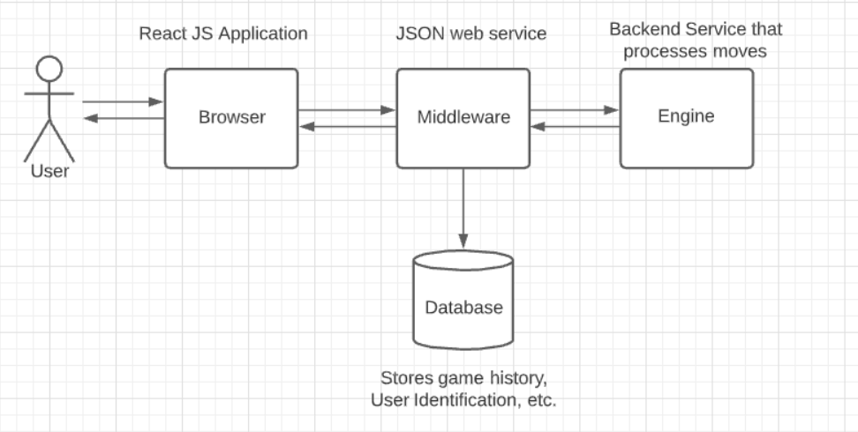

Slide 6
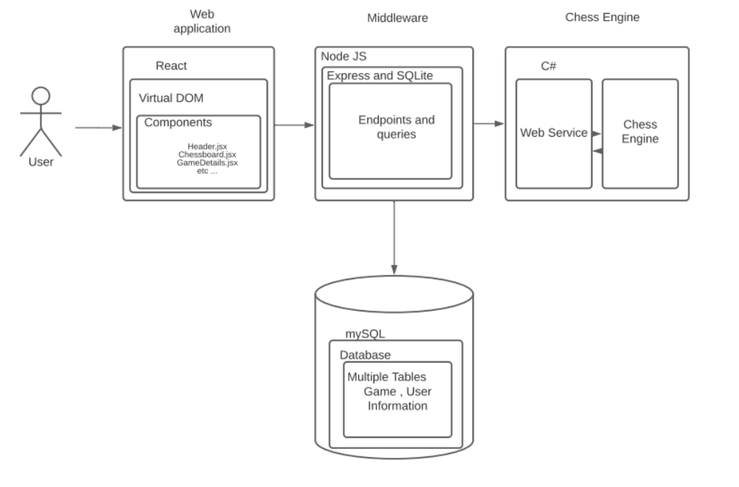

Slide 7
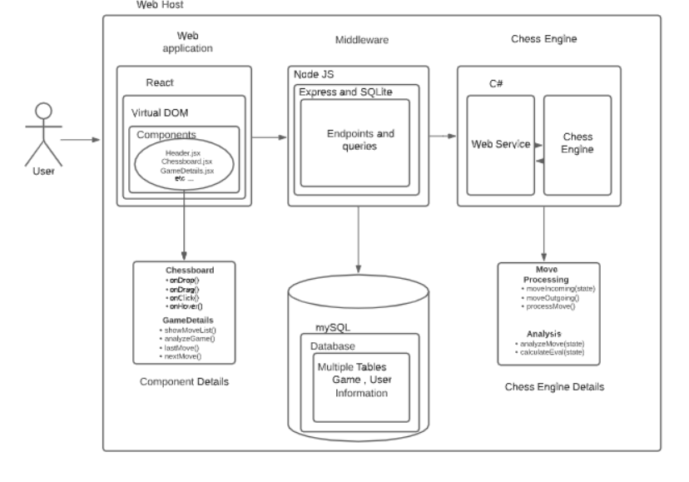

Slide 8
Major project constraints
Time
Look and Feel
Project Scope

Slide 9
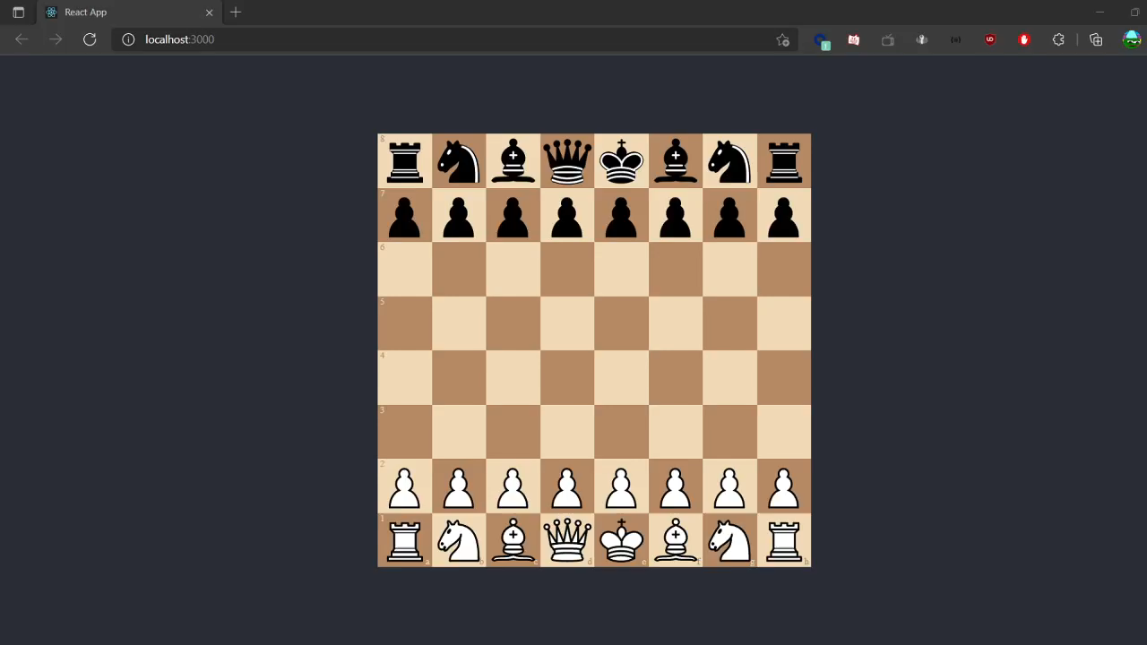
Current progress

Slide 10
Expected accomplishment by end of term
Design the layout of the web application.
Create a basic structure for the chess engine.
Research basic and common machine learning
Create database diagrams
Build Data Access Layers (connect database to code base)
Initialize a basic chess board using chessboardjsx
Initialize and implement game logic using chess.js library

Slide 11
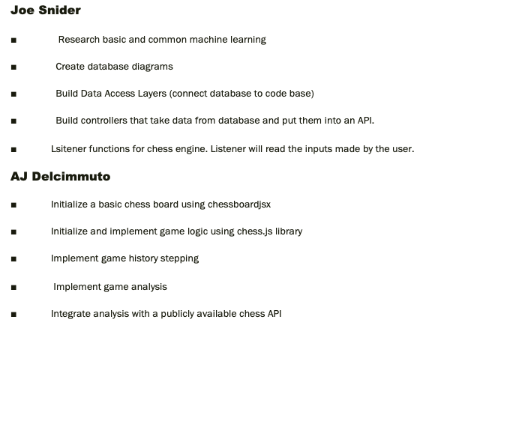
DIVISION OF WORK
Rouba Al-Khasawneh
Design the layout of the web application.
Develop the web application using react and VDOM.
Incorporate the components of the web application.
Test the web application for accuracy in performance.
Validate that the web app is ready for the chess engine to be hosted on it.
Chris Tatlonghari
Create a basic structure for the chess engine.
Create Database using mySQL - This will be used for storing history, and user account information.
Develop a basic utility function for the chess engine that picks the best move from a list of possible moves.
Develop a web service to allow communication between the middleware and the engine.
Research useful C# libraries for chess logic.

Slide 12
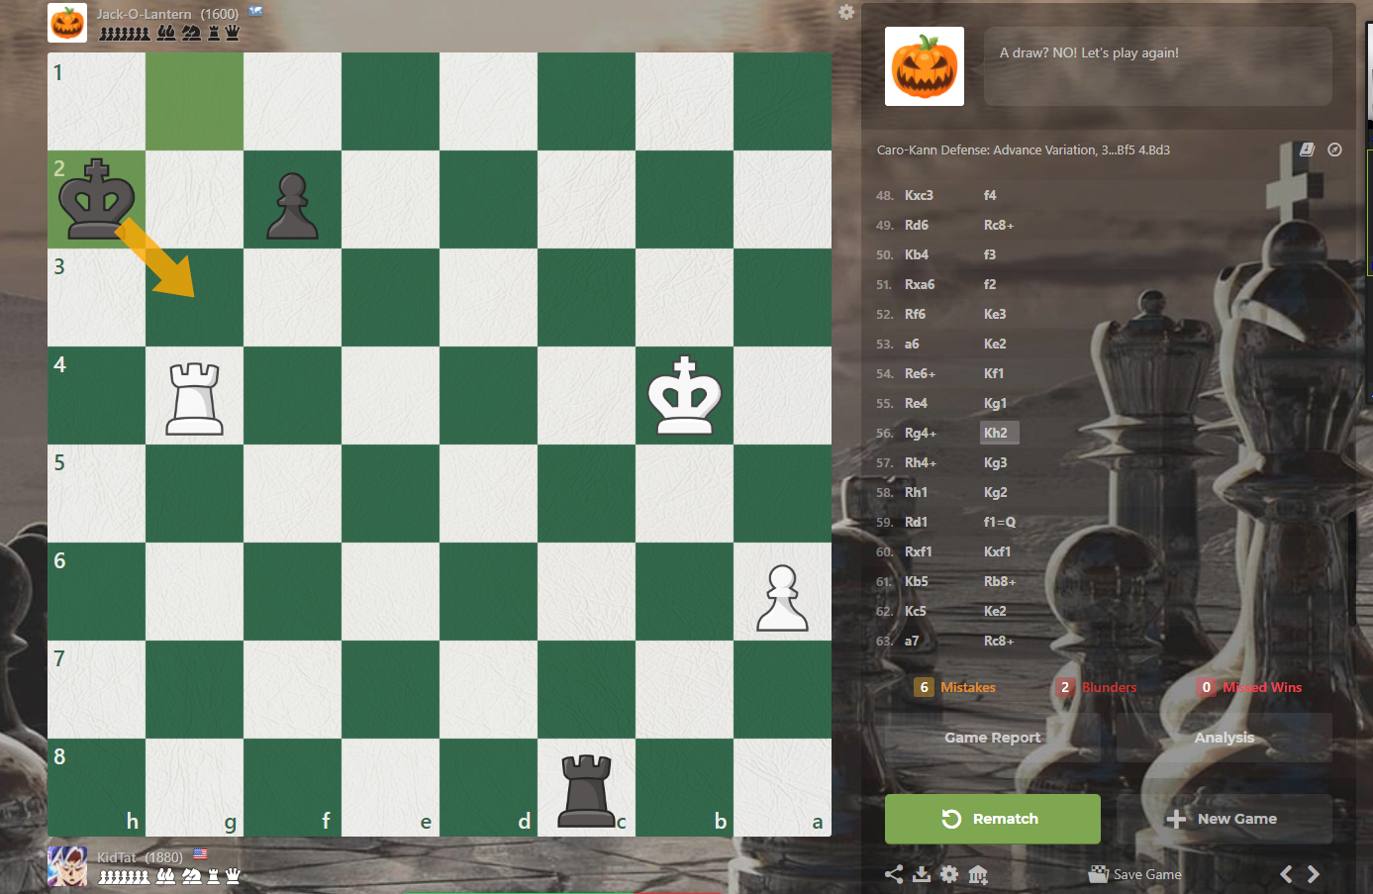
Expected demo

